Slide 1
Event Recognition

Slide 2
Introduction
Video is the most convenient means of communication. Various entities can be determined through the videos like emotion, feelings, activity, action, event etc. The events can be defined by the interaction among different entities such humans and objects in the video.
Events are complex in nature to be recognized and depend upon several factors including human poses, facial expressions, garments and object-scene contexts. Therefore object detection is first phase of event recognition.

Slide 3
Related work
Some work proposed by various researchers in the similar context:
The use of CNN to recognize activity in a scene has been proposed in [1]. In this paper author uses Object-Scene Convolutional Neural Networks to extract the important visual aspects of object as well as scene for understanding of activities. The OS- CNN is dissolved into two separate nets, namely object net and scene net. However the problem with OS-CNN is that object net is outperformed by scene net for the detection of activities. Also there exists complementary property between object and scene nets for the detection of activities.

Slide 4
Visual Activities Recognition through videos was proposed in [3]. In this paper pyramid matching method ASPTM and A-MKL are used. It performs the fusing of information from different levels of pyramids and different types of local features. It also copes with the mismatch between the feature distributions of videos of consumers and web. However, the problem is that the author recognized the images and videos with very few labeled samples.

Slide 5
Proposed Work
The proposed approach consists of four phases to recognize the activities:
(a)Object detection
(b)Pose estimation
(c)Human tracking
(d)Pose-based Action Recognition

Slide 6
(a)Object detection
To estimate a human presence in the image an algorithm capable of detecting human is to be used. There are the basic factors which decides the suitable selection of an object detection capable algorithm.
In this project YOLO(You Only Look Once) algorithm has been used to identify the objects present in the image.

Slide 7
(b)Pose estimation
Post estimation approach is used for detection of human pose . It captures humans as objects and then an estimation of a human skeleton is done in this cropped region. A heat map is predicted through the pose recognition algorithms.

Slide 8
(c)Human tracking
The skeletal information of a human is necessary for recognizing events or activities in different frames. The human skeleton in different frames are absolute as the proposed algorithm is implemented on single static images

Slide 9
(d)Pose-based Action Recognition
In the proposed model, we have investigated an approach of encoding human skeletons in form of data structure resembling images. This process is initiated by extracting the human pose from the web camera images.

Slide 10
Proposed Algorithm
The workflow of the algorithm begins with taking video as input to the model. Framing is performed on the input video. After the framing using the YOLO algorithm object detection is performed using bounding boxes. From this information the boxes containing human information is extracted. Then we get the joints' positions by Open Pose. It tracks each skeleton present in the frame. After this the Euclidean distance between the joints of two skeletons is used for matching two skeletons. It then fills in a person's missing joints by these joints' relative position in previous frame.

Slide 11
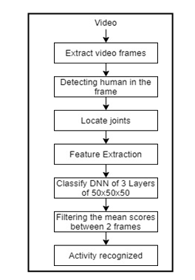

Slide 12
Data Used
The dataset is composed of 1528 videos from different standard video datasets like JHMDB HMDB52, UCF101, KTH which are classified in to 21 action classes: brush hair, catch, clap, climb stairs, golf, jump, kick ball, pick, pour, pull-up, push, run, shoot ball, shoot bow, shoot gun, sit, stand, swing baseball, throw, walk, wave.

Slide 13
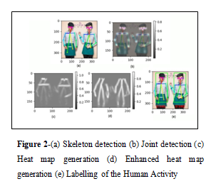
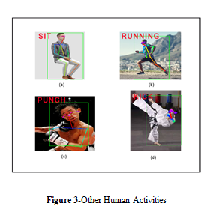
Results and analysis
The proposed model’s results are demonstrated through the figure 1 and 2.

Slide 14
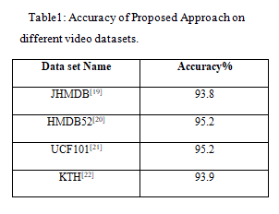

Slide 15
Conclusion and Future Work
In this work we have proposed a model that can recognize various activities done by humans in real time. In our proposed work human recognition is done by using object detection and activity detection with the help of Deep Neural Network (DNN).
For future point of view, we will include more number of activities.

Slide 16
REFERENCES
[1] Wang, Limin, Zhe Wang, Wenbin Du, and Yu Qiao. "Object-scene convolutional neural networks for activities recognition in images." In Proceedings of the IEEE conference on computer vision and pattern recognition workshops, pp. 30-35. 2015.
[2] Sandeep Rathor & R.S. Jadon, “Acoustic domain recognition using ensemble based multilevel classfication”, journal of Ambient computing and humanized computing (Springer), vol. 11, issue 9, pp.3617-3627.

Slide 17
[3] Duan, Lixin, et al. "Visual activities recognition in videos by learning from web data." IEEE Transactions on Pattern Analysis and Machine Intelligence 34.9 (2011): 1667-1680.
[4] Xiong, Y., Zhu, K., Lin, D., & Tang, X. (2015). Recognize complex activities from static images by fusing deep channels. In Proceedings of the IEEE Conference on Computer Vision and Pattern Recognition (pp. 1600-1609).
[5] Wang, L., Shi, J., Song, G., & Shen, I. F. (2007, November). Object detection combining recognition and segmentation. In Asian conference on computer vision (pp. 189-199). Springer, Berlin, Heidelberg.

Slide 18
THANK YOU

